Slide 1



Mini Project- on
“Attendance Face Recognition System“
Dept. of CS&E ( DATA SCIENCE)
Adichunchanagiri Institute of Technology
Chikkamagaluru - 577102
Presented By,
Name : Sankalp S (4AI22CD046)
Name : Md Shakir (4AI22CD036)
Name : Sohan Arya (4AI22CD051)
Name : Ganesh Naik (4AI22CD021)
Under the Guidance of
Prof. Shilpa K V

Slide 2
Problem Statement
To design and implement a system that can collect and store facial data that raises significant privacy issues. The system may struggle especially in lighting conditions, different angles, or when individuals change their appearance (e.g., hairstyles, glasses etc..).

Slide 3
Scope of the project
Key areas the project focuses on:
Face Detection and Recognition: Automated identification and verification of individuals using facial recognition technology.
Automated Attendance Logging: Real-time attendance recording without manual input, reducing errors and time consumption.

Slide 4
Benefits
Increased Accuracy: Minimizes human errors and eliminates proxy attendance.
Cost-Effective: Reduces the need for physical resources (e.g., paper) and minimizes manual work for teachers.

Slide 5
Project Design
Components involved (hardware/software architecture)
1. Hardware Components:-
Camera (Webcam or High-Resolution Camera): Captures real-time images or videos of individuals for face detection and recognition.
Computer: It Processes the captured images, runs facial recognition algorithms, and stores attendance data in the database.
2. Software Components:-
Face Detection and Recognition Software: Utilizes machine learning algorithms like OpenCV to detect and recognize faces in real-time.
Attendance Management Software: Integrates face recognition with attendance marking and report generation.

Slide 6
Methodology
The methodology of an attendance face recognition system typically involves these steps:-
Image Capture: The system captures the user's facial image using a camera.
Face Detection: The captured image is processed to detect and extract facial features.
Face Recognition: The extracted features are compared with pre-registered data to identify the individual.
Attendance Marking: If the face is recognized, the corresponding attendance entry is marked in the database.

Slide 7
Implementation
Attendance face recognition systems are used in schools, colleges, and offices for efficient and automated attendance tracking. They are also utilized in events and security systems to monitor and verify the presence of individuals.
+---------------------+ +------------------------+ +-------------------------+
| Camera/Scanner | ---> | Face Detection & | ---> | Recognition Algorithm | --->|
| (captures image/video) | | Recognition Module | | (matches face to data) | |
+---------------------+ +------------------------+ +-------------------------+ |
| |
v v
+------------------+ +-------------------+
| Database | | User Interface |
| (Stores Data & | | (Admin & User UI) |
| Attendance Log) | +-------------------+
+------------------+ |
| |
v v
+------------------+ +-------------------+
| Attendance Log | | Optional Systems |
| (Records for | | (HR, Payroll) |
| each individual) | | |
+------------------+ +-------------------+

Slide 8
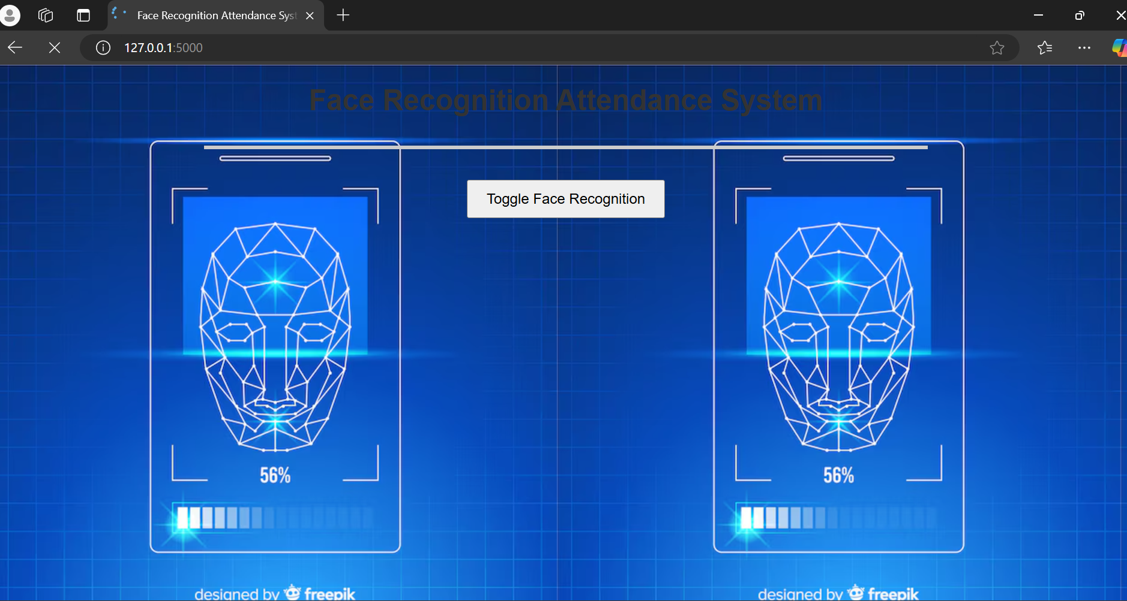
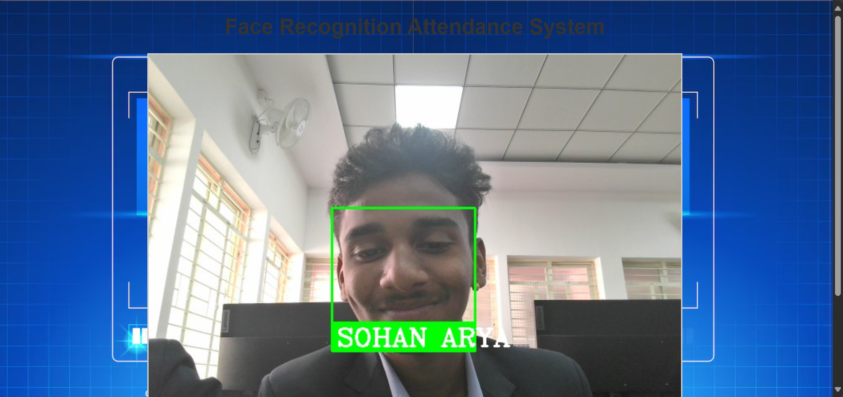
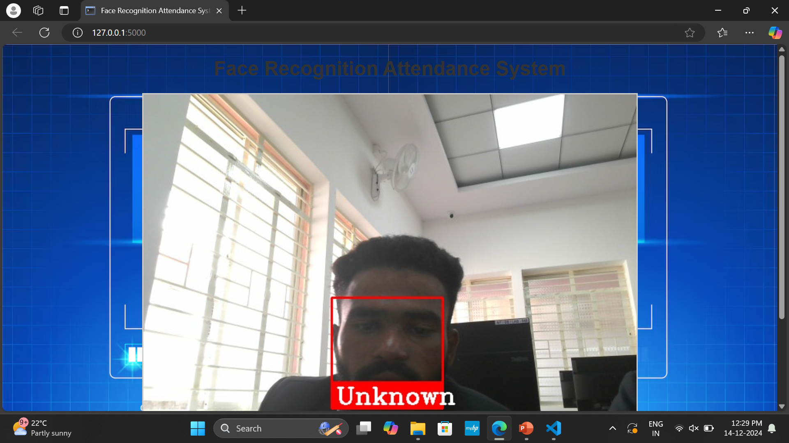
Results
Outcomes/Outputs:-
Automated Attendance Management Elimination of Manual Processes : Attendance is marked automatically, reducing the need for manual roll calls or paper-based systems . Time Savings : Real-time recognition drastically reduces the time required for attendance marking.
Improved Accuracy Minimized Errors : Reduces human errors such as miscounting or recording incorrect data .

Slide 9
Challenges Faced
1.Data Quality and Collection:
Issue: Poor image quality, inconsistent lighting, and varying orientations.
Resolution: Used preprocessing data augmentation, and collected diverse images under various conditions.
2.Recognition Accuracy:
Issue: Difficulty recognizing faces in low-light or occluded conditions.
Resolution: Applied advanced algorithms (e.g., CNNs, Face Net) and used hybrid models for better accuracy.

Slide 10
Future Work
Scalability: Improving the system to handle larger groups of people and allowing easy updates using cloud technology.
Fairness: Ensuring the system works equally well for all people, regardless of their appearance.
Better Accuracy: Making the system more accurate, even in difficult conditions like low light .

Slide 11
Conclusion
In summary, an attendance face recognition system is a fast, secure, and efficient way to track attendance by recognizing individual 's faces. It reduces manual effort and increases accuracy. While challenges like privacy issues and accuracy in difficult conditions exist, these can be solved with better technology and security measures.

Slide 12
GitHub Link
https://github.com/Sankalp21-ui/Attendance-face-Recognition-system
https://github.com/MSshakir/Attendance-face-Recognition-system/upload
https://github.com/ganeshmnaik12/Attendance-Face-Recognition-system/upload
https://github.com/SohanArya29/Attendance-Face-Recognition-System/upload

Slide 13
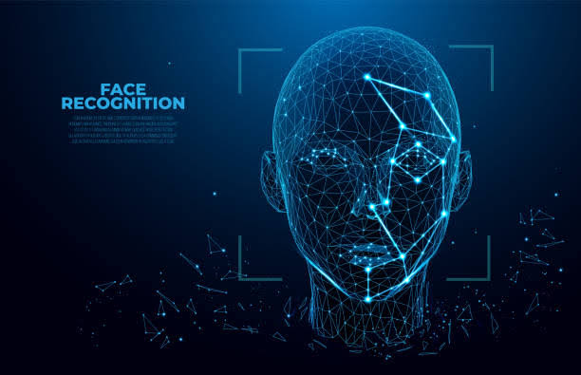
THANK YOU

